Slide 1
Internet of Things Reverse Engineering with Ghidra
Troy Shurtleff (Author)
Copyright, 2019 BAE Systems
Licensed under the Apache License, Version 2.0 (the "License"); you may not use this file except in compliance with the License. You may obtain a copy of the License at
https://www.apache.org/licenses/LICENSE-2.0. Unless required by applicable law or agreed to in writing, software distributed under the License is distributed on an "AS IS" BASIS, WITHOUT WARRANTIES OR CONDITIONS OF ANY KIND, either express or implied. See the License for the specific language governing permissions and limitations under the License.
© BAE Systems
9/29/2019 14:00

Slide 2
Background and Introduction

Slide 3
What is Software Reverse Engineering?
In 1990 Elliot Chikofsky and Dr. James Cross defined reverse engineering in the context of software as follows [1]:
In a security context, reverse engineering is often performed to
identify or characterize vulnerabilities and/or
develop exploits for those vulnerabilities
As with almost anything in the security domain intentions can either be malicious or non-malicious
Here we examine the whys and hows of software reverse engineering...
Reverse engineering is the process of analyzing a subject system to
identify the system’s components and their interrelationships and
create representations of the system in another form or at a higher level of abstraction.
Notes:
[1] E. J. Chikofsky and J. H. Cross, “Reverse engineering and design recovery: A taxonomy,” IEEE Software, vol. 7, pp. 13-17, 1990.

Slide 4
Why Reverse Engineer Software?
Malware
Malware authors may reverse engineer software to identify vulnerabilities and develop exploits
Current generations of IoT malware move beyond using default credentials and are now exploiting other software vulnerabilities in devices [2]
Defenders may reverse engineer malware to understand the purpose of the malware, understand exploitation techniques used and develop solutions to detect and prevent infections from the same or similar malware
Notes:
[2] Trend Micro Inc., “Back-to-Back Campaigns: Neko, Mirai, and Bashlite Malware Variants Use Various Exploits to Target Several Routers, Devices,” Trend Micro Security Intelligence Blog, Aug. 13, 2019. [Online]. Available: https://blog.trendmicro.com/trendlabs-security-intelligence/back-to-back-campaigns-neko-mirai-and-bashlite-malware-variants-use-various-exploits-to-target-several-routers-devices/. [accessed Aug. 30, 2019].

Slide 5
Why Reverse Engineer Software?
Digital Rights Management
Content providers often implement cryptologic controls to protect their intellectual property
Malicious reverse engineers make seek flaws in the cryptographic algorithms or, more commonly, their implementations
In 2010 the failoverflow group recovered Sony’s private ECDSA signing key because of a flawed signing process [3] [4]
This allowed others to sign alternative software so it would run on the PS3
Members of the failoverflow group faced severe legal penalties, mostly stemming from the way they irresponsibly disclosed their findings
Notes:
[3] S. Hollister, “Hackers obtain PS3 private cryptography key due to epic programming fail? (update),” Engadget, Dec. 29, 2010. [Online]. Available: https://www.engadget.com/2010/12/29/hackers-obtain-ps3-private-cryptography-key-due-to-epic-programm/. [Accessed Aug. 30, 2019].
[4] C. Johnston, “PS3 hacked through poor cryptography implementation,” Ars Technica, Dec. 20, 2010. [Online]. Available: https://arstechnica.com/gaming/2010/12/ps3-hacked-through-poor-implementation-of-cryptography/. [Accessed Aug. 30, 2019].

Slide 6
Why Reverse Engineer Software?
Security Auditing
Device and software vendors often enlist white-hat reverse engineers to identify vulnerabilities and develop proof-of-concept exploits
These white-hats use the same tools and techniques as malicious black-hats
Responsibly disclosing vulnerabilities to vendors is critically important
Responsible disclosure allows vendors to patch vulnerabilities to protect consumers
Irresponsible disclosure creates opportunities for malicious attackers to develop and deliver exploits
This can have severe adverse impacts to consumers, vendors, and other members of the public who may be indirectly affected

Slide 7
Types of Code
You will encounter different types of “code” when reverse engineering software
It is important to be specific about what type of code you are referring to when communicating
Source Code
Written in a high-level programming language with no direct association with a specific processor architecture
Assembly Code
Written in a low-level programming language directly associated with a specific processor architecture
Machine Code
Binary representation of instructions that can be executed directly on a specific processor architecture

Slide 8
Source Code
Most modern software is written by human programmers in the form of source code
There are a variety of programming languages available, each with different features suitable for different types of applications (e.g. - C, C++, Java, JavaScript, Python)
Source code is not associated with specific processor architectures
Source code is expressed in a text-based form that is readily understood by humans
There may be comments that aid in understanding
Programming languages have a variety of constructs that are intuitively understood (e.g. loops, conditional statements)

Slide 9
Assembly Code
Assembly code is written in a lower level programming language associated with a specific processor architecture (e.g. x86, ARM, MIPS)
Typically, software is written in a source code language and the assembly code is generated by a compiler
Assembly code does contain elements to make it more understandable to humans
Mnemonics to represent lower level machine language opcodes, which are part of instructions
Instructions may also include operands
Assembly code often includes labels and assembler directives for clarity
For example, labels in handwritten assembly code help avoid the need to keep modifying specific references to offsets elsewhere in the code as instructions are added, removed, or modified

Slide 10
Machine Code
Machine code is a binary representation of instructions to be executed by a processor with a specific architecture (e.g. x86, ARM, MIPS)
Machine code is not intended to be readily understood by humans
The translation between assembly code instructions and machine code instructions is 1-to-1
The “forward engineering” process involves a translation from assembly code to machine code
Because there is a 1-to-1 relationship between assembly code instructions and machine code instructions, there are a variety of algorithms that do a reasonable job disassembling machine code (i.e. machine code to assembly code)
For example, linear sweep and recursive descent are two primary disassembly algorithms
As a reverse engineer, you should understand that these algorithms are not perfect and there are anti-reversing techniques specifically intended to make these translations fail

Slide 11
Building Software: From Source to Executable
Preprocessing
Compilation
Assembly
Linking
Processes directives embedded in the original source code.
Directives may include contents of source files, conditionally include or exclude blocks of source code, or perform substitutions in the source code.
Translates preprocessed source code into assembly code.
Several types of optimizations can be applied (e.g. speed, size, ease of debugging) so this translation from source to assembly code is not 1-to-1.
Translates assembly code into machine code instructions.
The result is a relocatable object file that itself is not executable on the target system.
Assembly code is a low level symbolic representation of machine code and this translation from assembly to machine code is 1-to-1
Combines a set of relocatable object files to produce either an executable object file or a shared object file.
Executable object files contain programs that can be executed directly.
Shared object files can be statically linked with other object files or can be dynamically linked at process load-time or during run-time

Slide 12
Reversing Software
Preprocessing
Compilation
Assembly
Linking
Decompilation
Disassembly
Translates assembly code into a source code representation that reasonably resembles the original source code.
Because of preprocessing and optimization during the forward process, the result of decompilation rarely matches the original source exactly.
Translates machine code instructions into assembly code.
The input file likely contains both instructions and data. Different disassemblers and algorithms vary in their ability to correctly distinguish the two in all cases.
Reverse engineers can aid the process, using tools, to improve the outcome

Slide 13
Reverse Engineering Demonstration
hello, world

Slide 14
Reverse Engineering Demonstration
Forward Process
Goal
Given a simple expression of the program requirements and design, produce an executable program that meets the requirements and is aligned with the design intent
Approach:
The source code is written in C
Target system
Operating System: Linux
Architecture: ARM
We use an ARM cross compiler (arm-linux-gnueabi-gcc) to build the software
Reverse Process
Goal:
Given only an executable program, understand the original program requirements and design
Approach:
Use Ghidra to reverse the executable program to the point where we have a reasonable representation of the original source code

Slide 15
Reverse Engineering Demonstration
The Forward Process

Slide 16
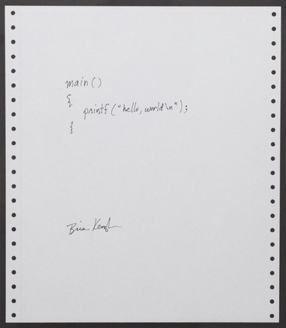
Where to Begin
For this demonstration, we focus on the forward process steps that span the authoring of source code to the production of an executable program
Before reaching the point of authoring source code, engineers capture its intended capabilities and design in a variety of artifacts
Requirements documents, UML diagrams (use case, sequence, state machine)
As reverse engineers, we may seek to understand the requirements and design or we may simply want to find flaws in the implementation
In either case, these steps we examine here are where we will likely focus most of our efforts
Original Expression of Requirements and Design
Brian Kernighan, 1978, Public Domain
https://commons.wikimedia.org/wiki/File:Hello_World_Brian_Kernighan_1978.jpg

Slide 17
Writing the Original Source Code
Initially, programmers translate some expression of the intended design into source code
// This program prints "hello, world"
#define NAME "world"
int main( ) {
char * name = NAME;
printf("hello, %s\n", name);
}
Original Expression of Requirements and Design
Original Source Code
(helloworld.c)
Brian Kernighan, 1978, Public Domain
https://commons.wikimedia.org/wiki/File:Hello_World_Brian_Kernighan_1978.jpg

Slide 18
Original Source Code Observations
A comment to aid understanding
// This program prints "hello, world"
#define NAME "world"
int main( ) {
char * name = NAME;
printf("hello, %s\n", name);
}
A preprocessor directive to perform source code substitution prior to compilation
A local variable
A library function call
Original Source Code
(helloworld.c)
This source code contains elements intended to help understand what the code is doing and aid maintainability over its lifecycle

Slide 19
Preprocessing
Preprocessing
Compilation
Assembly
Linking
The C preprocessor removes comments and applies the macros and directives
// This program prints "hello, world"
#define NAME "world"
int main( ) {
char * name = NAME;
printf("hello, %s\n", name);
}
int main( ) {
char * name = "world";
printf("hello, %s\n", name);
}
Preprocessed Source Code
(helloworld.i)
Original Source Code
(helloworld.c)
$ arm-linux-gnueabi-gcc -E helloworld.c -o helloworld.i

Slide 20
Compilation
Preprocessing
Compilation
Assembly
Linking
The compiler translates the preprocessed source code into assembly code
.LC1:
.ascii "hello, %s\012\000"
.LC0:
.ascii "world\000"
main:
push {fp, lr}
add fp, sp, #4
sub sp, sp, #8
ldr r3, .L3
str r3, [fp, #-8]
<snip>
int main( ) {
char * name = "world";
printf("hello, %s\n", name);
}
Preprocessed Source Code
(helloworld.i)
Assembler Code
(helloworld.s)*
* Partially shown
$ arm-linux-gnueabi-gcc -S helloworld.i -o helloworld.s -w

Slide 21
Assembler Code Observations
An assembler directive(begins with a ‘.’)
The ‘.ascii’ directive tells the assembler to replace each character with its ASCII byte value in the output file
.LC1:
.ascii "hello, %s\012\000"
.LC0:
.ascii "world\000"
main:
push {fp, lr}
add fp, sp, #4
sub sp, sp, #8
ldr r3, .L3
str r3, [fp, #-8]
<snip>
A label(ends with a ‘:’)
Labels represent the current location in the output file and can be used as an instruction operand
An ARM assembly instruction
This instruction subtracts the value 8 (decimal) from the value stored in the ‘sp’ register (stack pointer) and stores the result in the ‘sp’ register
Assembler Code
(helloworld.s)*
* Partially shown
An ARM assembly instruction with a label reference
This instruction loads the immediate offset represented by the ‘.L3’ label into the ‘r3’ register.
This assembler code contains elements intended aid human understanding

Slide 22
Assembly
Preprocessing
Compilation
Assembly
Linking
.LC1:
.ascii "hello, %s\012\000"
.LC0:
.ascii "world\000"
main:
push {fp, lr}
add fp, sp, #4
sub sp, sp, #8
ldr r3, .L3
str r3, [fp, #-8]
<snip>
Offset | Byte Values (Hexadecimal)
-------+---------------------------------
0x0074 | 68 65 6c 6c 6f 2c 20 25 73 0a 00
|
0x006c | 77 6f 72 6c 64 00
|
0x0034 | 00 48 2d e9
0x0038 | 04 b0 8d e2
0x003C | 08 d0 4d e2
0x0040 | 1c 30 9f e5
0x0044 | 08 30 0b e5
Assembler Code
(helloworld.s)*
* Partially shown
Machine Code
(helloworld.o)*
* Partially shown
$ arm-linux-gnueabi-gcc -c helloworld.s -o helloworld.o

Slide 23
Relocatable Object File Observations
Preprocessing
Compilation
Assembly
Linking
The assembler translated the data and assembly code instructions in the assembler file (helloworld.s) into data and machine code instructions in the output file (helloworld.o)
The output file is a relocatable object file that must be linked with other object files to create either an executable file or a shared object file
$ file helloworld.o
helloworld.o: ELF 32-bit LSB relocatable, ARM, EABI5 version 1 (SYSV), not stripped

Slide 24
Relocatable Object File Observations
Preprocessing
Compilation
Assembly
Linking
$ hexdump -C helloworld.o
00000000 7f 45 4c 46 01 01 01 00 00 00 00 00 00 00 00 00 |.ELF............|
00000010 01 00 28 00 01 00 00 00 00 00 00 00 00 00 00 00 |..(.............|
00000020 58 02 00 00 00 00 00 05 34 00 00 00 00 00 28 00 |X.......4.....(.|
00000030 0c 00 0b 00 00 48 2d e9 04 b0 8d e2 08 d0 4d e2 |.....H-.......M.|
00000040 10 9f ec 35 08 30 0b e5 08 10 1b e5 14 00 9f e5 |.0...0..........|
00000050 fe ff ff eb 00 30 a0 e3 03 00 a0 e1 04 d0 4b e2 |.....0........K.|
00000060 00 88 bd e8 00 00 00 00 08 00 00 00 77 6f 72 6c |............worl|
00000070 64 00 00 00 68 65 6c 6c 6f 2c 20 25 73 0a 00 00 |d...hello, %s...|
00000080 47 43 43 3a 20 28 55 62 75 6e 74 75 2f 4c 69 6e |GCC: (Ubuntu/Lin|
00000090 61 72 6f 20 37 2e 34 2e 30 2d 31 75 62 75 6e 74 |aro 7.4.0-1ubunt|
000000a0 75 31 7e 31 38 2e 30 34 2e 31 29 20 37 2e 34 2e |u1~18.04.1) 7.4.|
000000b0 30 00 41 29 00 00 00 61 65 61 62 69 00 01 1f 00 |0.A)...aeabi....|
000000c0 00 00 05 35 54 00 06 03 08 01 09 01 12 04 14 01 |...5T...........|
000000d0 15 01 17 03 18 01 19 01 1a 02 1e 06 00 00 00 00 |................|
000000e0 00 00 00 00 00 00 00 00 00 00 00 00 01 00 00 00 |................|
000000f0 00 00 00 00 00 00 00 00 04 00 f1 ff 00 00 00 00 |................|
00000100 00 00 00 00 00 00 00 00 03 00 01 00 00 00 00 00 |................|
00000110 00 00 00 00 00 00 00 00 03 00 03 00 00 00 00 00 |................|
00000120 00 00 00 00 00 00 00 00 03 00 04 00 00 00 00 00 |................|
00000130 00 00 00 00 00 00 00 00 03 00 05 00 0e 00 00 00 |................|
00000140 00 00 00 00 00 00 00 00 00 00 05 00 11 00 00 00 |................|
00000150 00 00 00 00 00 00 00 00 00 00 01 00 0e 00 00 00 |................|
00000160 30 00 00 00 00 00 00 00 00 00 01 00 00 00 00 00 |0...............|
00000170 00 00 00 00 00 00 00 00 03 00 07 00 00 00 00 00 |................|
00000180 00 00 00 00 00 00 00 00 03 00 06 00 00 00 00 00 |................|
00000190 00 00 00 00 00 00 00 00 03 00 08 00 14 00 00 00 |................|
000001a0 00 00 00 00 38 00 00 00 12 00 01 00 19 00 00 00 |....8...........|
000001b0 00 00 00 00 00 00 00 00 10 00 00 00 00 68 65 6c |.............hel|
000001c0 6c 6f 77 6f 72 6c 64 2e 63 00 24 64 00 24 61 00 |loworld.c.$d.$a.|
000001d0 6d 61 69 6e 00 70 72 69 6e 74 66 00 1c 00 00 00 |main.printf.....|
000001e0 1c 0d 00 00 30 00 00 00 02 05 00 00 34 00 00 00 |....0.......4...|
000001f0 02 05 00 00 00 2e 73 79 6d 74 61 62 00 2e 73 74 |......symtab..st|
00000200 72 74 61 62 00 2e 73 68 73 74 72 74 61 62 00 2e |rtab..shstrtab..|
00000210 72 65 6c 2e 74 65 78 74 00 2e 64 61 74 61 00 2e |rel.text..data..|
00000220 62 73 73 00 2e 72 6f 64 61 74 61 00 2e 63 6f 6d |bss..rodata..com|
00000230 6d 65 6e 74 00 2e 6e 6f 74 65 2e 47 4e 55 2d 73 |ment..note.GNU-s|
00000240 74 61 63 6b 00 2e 41 52 4d 2e 61 74 74 72 69 62 |tack..ARM.attrib|
00000250 75 74 65 73 00 00 00 00 00 00 00 00 00 00 00 00 |utes............|
00000260 00 00 00 00 00 00 00 00 00 00 00 00 00 00 00 00 |................|
*
00000280 1f 00 00 00 01 00 00 00 06 00 00 00 00 00 00 00 |................|
00000290 34 00 00 00 38 00 00 00 00 00 00 00 00 00 00 00 |4...8...........|
000002a0 04 00 00 00 00 00 00 00 1b 00 00 00 09 00 00 00 |................|
000002b0 40 00 00 00 00 00 00 00 dc 01 00 00 18 00 00 00 |@...............|
000002c0 09 00 00 00 01 00 00 00 04 00 00 00 08 00 00 00 |................|
000002d0 25 00 00 00 01 00 00 00 03 00 00 00 00 00 00 00 |%...............|
000002e0 6c 00 00 00 00 00 00 00 00 00 00 00 00 00 00 00 |l...............|
000002f0 01 00 00 00 00 00 00 00 2b 00 00 00 08 00 00 00 |........+.......|
00000300 03 00 00 00 00 00 00 00 6c 00 00 00 00 00 00 00 |........l.......|
00000310 00 00 00 00 00 00 00 00 01 00 00 00 00 00 00 00 |................|
00000320 30 00 00 00 01 00 00 00 02 00 00 00 00 00 00 00 |0...............|
00000330 6c 00 00 00 13 00 00 00 00 00 00 00 00 00 00 00 |l...............|
00000340 04 00 00 00 00 00 00 00 38 00 00 00 01 00 00 00 |........8.......|
00000350 30 00 00 00 00 00 00 00 7f 00 00 00 33 00 00 00 |0...........3...|
00000360 00 00 00 00 00 00 00 00 01 00 00 00 01 00 00 00 |................|
00000370 41 00 00 00 01 00 00 00 00 00 00 00 00 00 00 00 |A...............|
00000380 b2 00 00 00 00 00 00 00 00 00 00 00 00 00 00 00 |................|
00000390 01 00 00 00 00 00 00 00 51 00 00 00 03 00 00 70 |........Q......p|
000003a0 00 00 00 00 00 00 00 00 b2 00 00 00 2a 00 00 00 |............*...|
000003b0 00 00 00 00 00 00 00 00 01 00 00 00 00 00 00 00 |................|
000003c0 01 00 00 00 02 00 00 00 00 00 00 00 00 00 00 00 |................|
000003d0 dc 00 00 00 e0 00 00 00 0a 00 00 00 0c 00 00 00 |................|
000003e0 04 00 00 00 10 00 00 00 09 00 00 00 03 00 00 00 |................|
000003f0 00 00 00 00 00 00 00 00 bc 01 00 00 20 00 00 00 |............ ...|
00000400 00 00 00 00 00 00 00 00 01 00 00 00 00 00 00 00 |................|
00000410 11 00 00 00 03 00 00 00 00 00 00 00 00 00 00 00 |................|
00000420 f4 01 00 00 61 00 00 00 00 00 00 00 00 00 00 00 |....a...........|
00000430 01 00 00 00 00 00 00 00 |........|
00000438
Notes:
The highlighted bytes are the ones shown on the previous “Assembly” slide

Slide 25
Linking
Preprocessing
Compilation
Assembly
Linking
$ readelf -h helloworld.o
ELF Header:
Magic: 7f 45 4c 46 01 01 01 00 00 00 00 00 00 00 00 00
Class: ELF32
Data: 2's complement, little endian
Version: 1 (current)
OS/ABI: UNIX - System V
ABI Version: 0
Type: REL (Relocatable file)
Machine: ARM
Version: 0x1
Entry point address: 0x0
Start of program headers: 0 (bytes into file)
Start of section headers: 600 (bytes into file)
Flags: 0x5000000, Version5 EABI
Size of this header: 52 (bytes)
Size of program headers: 0 (bytes)
Number of program headers: 0
Size of section headers: 40 (bytes)
Number of section headers: 12
Section header string table index: 11
$ readelf -h helloworld
ELF Header:
Magic: 7f 45 4c 46 01 01 01 00 00 00 00 00 00 00 00 00
Class: ELF32
Data: 2's complement, little endian
Version: 1 (current)
OS/ABI: UNIX - System V
ABI Version: 0
Type: EXEC (Executable file)
Machine: ARM
Version: 0x1
Entry point address: 0x10310
Start of program headers: 52 (bytes into file)
Start of section headers: 6884 (bytes into file)
Flags: 0x5000200, Version5 EABI, soft-float ABI
Size of this header: 52 (bytes)
Size of program headers: 32 (bytes)
Number of program headers: 9
Size of section headers: 40 (bytes)
Number of section headers: 29
Section header string table index: 28
Machine Code
(helloworld.o)*
* Partially shown
Machine Code
(helloworld)*
* Partially shown
$ arm-linux-gnueabi-gcc helloworld.o -o helloworld

Slide 26
Executable File Observations
Preprocessing
Compilation
Assembly
Linking
The linker linked our relocatable object file with other object files to create an ELF executable file
Because we built the executable for the ARM architecture we need to use the qemu-arm emulator to run it on our x86_64 system
$ file helloworld
helloworld: ELF 32-bit LSB executable, ARM, EABI5 version 1 (SYSV), dynamically linked, interpreter /lib/ld-, for GNU/Linux 3.2.0, BuildID[sha1]=0c4102eecea9b56c0a57e3c4cdb2d6c2667bc8a4, not stripped
$ qemu-arm -L /usr/arm-linux-gnueabi helloworld
hello, world
$

Slide 27
Reverse Engineering Demonstration
The Reverse Process

Slide 28
Where to Begin
We may only have a piece of executable software to begin our reverse engineering efforts
This is likely to be the case for a malware sample
If we are reverse engineering an IoT device, we may have a fully running system with associated configuration files
For this demonstration, we focus reversing the helloworld executable we just built to see how close we can get to the original source code
Often we aren’t able to validate our results because we don’t actually have the source code
We can probably gain some confidence in our conclusions with empirical evidence
Reversing is a very broad domain and here we focus specifically on the software code
For example, we may also reverse engineer protocols or system configurations

Slide 29
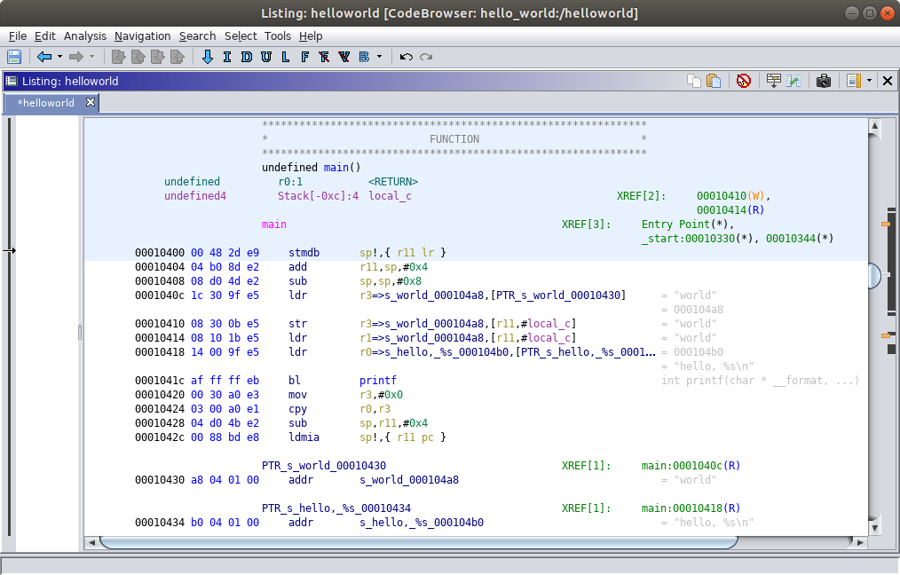
Disassembly
Decompilation
Disassembly
We load our helloworld ELF executable into Ghidra and get this result in the Listing view
Shown here is the main() function
Ghidra’s Disassembly
(helloworld)

Slide 30
Disassembly
Decompilation
Disassembly
ARM Machine Code Instructions and Data
Directly from the helloworld ELF executable
Ghidra’s Disassembly
(helloworld)

Slide 31
Disassembly
Decompilation
Disassembly
Memory Offsets
Ghidra’s Disassembly
(helloworld)

Slide 32
Disassembly
Decompilation
Disassembly
ARM
Assembly Code Instructions
Data
(pointers to strings)
Ghidra’s Disassembly
(helloworld)

Slide 33
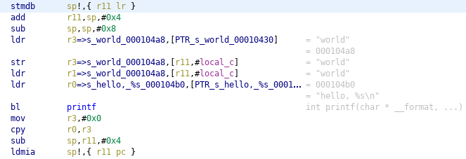
Disassembly Observations
In reality, we wouldn’t have access to the original assembler code (helloworld.s), but we can see Ghidra’s disassembly of the main() function is equivalent to the original assembler code from the forward process demonstration
push {fp, lr}
add fp, sp, #4
sub sp, sp, #8
ldr r3, .L3
str r3, [fp, #-8]
ldr r1, [fp, #-8]
ldr r0, .L3+4
bl printf
mov r3, #0
mov r0, r3
sub sp, fp, #4
pop {fp, pc}
Assembler Code
(helloworld.s)*
* Only the assembly code for the main function is shown
Ghidra’s Disassembly
(helloworld)*
* Only the (dis)assembly code for the main function is shown
Note:
“stmdb sp!,{ r11 lr }” is synonymous with “push {fp, lr}”
“ldmia sp!,{ r11 pc }” is synonymous with “pop {fp, pc}”

Slide 34
Disassembly Analysis
We can analyze the disassembly to begin to understand how the program works
In the analysis that follows we don’t follow the code “in order”
We begin by identifying the most recognizable constructs first
As we progress, we examine the more application-specific portions of our target sample

Slide 35
Disassembly of the main() Function
Identifying the function prologue and epilogue
Function Prologue
Function Epilogue

Slide 36
Disassembly of the main() Function
Populating the return value
Moving the value ‘0’ into the ‘r0’ register
‘The ‘r0’ register holds the function return value

Slide 37
Disassembly of the main() Function
Setting a local variable
Storing a pointer to the C string ‘world’ on the stack

Slide 38
Disassembly of the main() Function
Calling a function
Load a pointer to the C string ‘world’ into register ‘r1’
Load a pointer to the C string ‘hello. %s\n’ into register ‘r0’
Call the ‘printf’ function with the first argument held in register ‘r0’ and the second argument stored in register ‘r1’

Slide 39
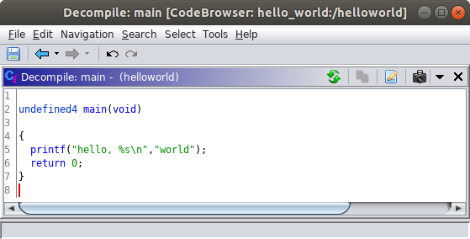
Decompilation
Decompilation
Disassembly
Ghidra also provides a This is Ghidra’s decompilation of the main() function
Ghidra’s Decompilation of the main function

Slide 40
Decompilation Observations
// This program prints "hello, world"
#define NAME "world"
int main( ) {
char * name = NAME;
printf("hello, %s\n", name);
}
In this case, Ghidra did a reasonable job creating a higher level representation of the original source code from the helloworld ELF executable.
Original Source Code
(helloworld.c)
Original Expression of Requirements and Design
Brian Kernighan, 1978, Public Domain
https://commons.wikimedia.org/wiki/File:Hello_World_Brian_Kernighan_1978.jpg
Ghidra’s Decompilation of the main function

Slide 41
Examining
Ghidra

Slide 42
A Deeper Dive into the Ghidra Tool
Ghidra is a software reverse engineering framework first released by the National Security Agency (NSA) in March, 2019. Primary capabilities include:
Disassembly
Results are highly annotated
Functions identified
Arguments and variables are identified
Cross references
Strings are shown
Decompilation
Provides a C language representation of the program
Reconstructs logical and mathematical expressions
Identifies arguments, variables, and function calls

Slide 43
Other Ghidra Features
Several integrated views of the program
Navigate easily between disassembly, decompilation, function listing, strings listing, memory map, etc.
Edit function signatures, argument and variable names
Add comments and annotations during manual analysis
Rich filtering interfaces
Scripting support to extend capabilities and automate tasks

Slide 44
Ghidra Supported Architectures
Ghidra supports a variety of architectures including:
X86
ARM
PowerPC
MIPS
Java bytecode

Slide 45
Ghidra Definitions
Program
A unit of software or data that can be viewed and analyzed within Ghidra
Supported formats include
Executable and Linkable Format (ELF)
Portable Executable (PE)
Raw binary files
Project
A collection programs and associated configuration information
Plugin
A building block that adds a unit of functionality to Ghidra.
Can be combined with other plugins to create higher level functionality
Ghidra comes with a set of plugins, but more can be added
Tool
A collection of plugins that together provide a GUI for performing reverse engineering tasks
Ghidra’s Code Browser tool is available by default and has all the Core plugins included
Additional tools can be defined
Refer to the glossary in the Ghidra Help for additional definitions

Slide 46
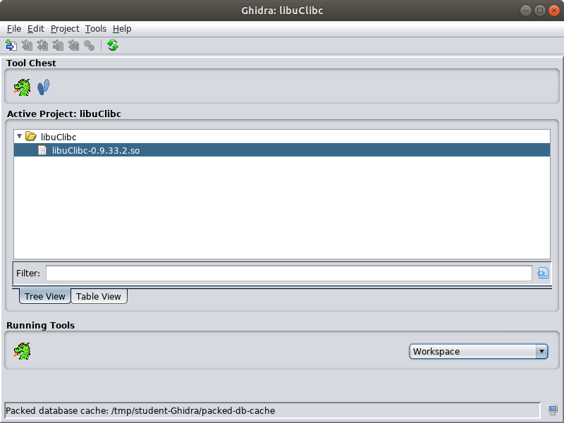
Ghidra Project Window
The first window you encounter after launching Ghidra is the Project Window
The Project Window is the interface for creating and managing projects
The Tool Chest
shows available tools
The dragon icon represents the
Code Browser tool
The Active Project panel shows the programs loaded into the current project and available for analysis

Slide 47
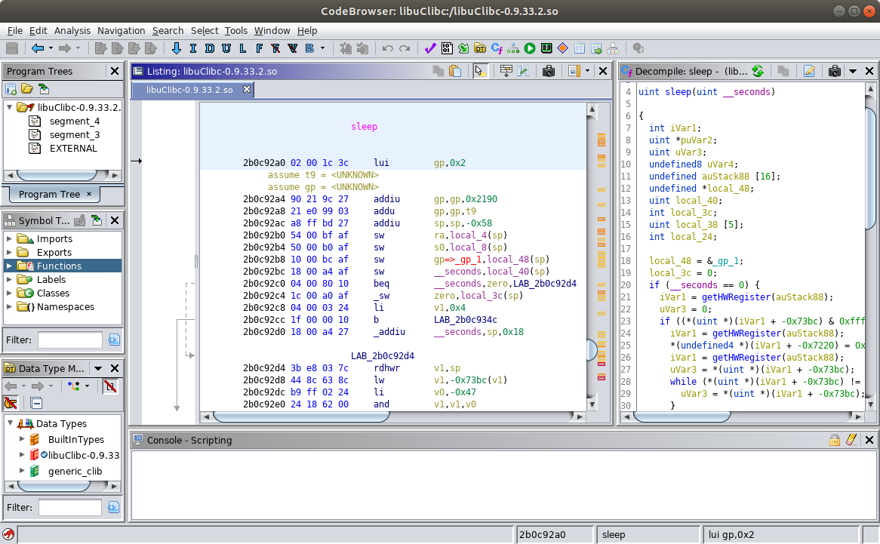
Code Browser Tool
The Code Browser tool is the primary GUI interface you will use
It contains a variety of visible views by default
Views can be moved by clicking the title bar then dragging the tool
Views can be moved within the main Code Browser window or fully detached
Additional views can be added by selecting them from the Window menu

Slide 48
Code Browser Tool: Default Views
Program Trees
View
Decompiler View
Symbol Tree
View
Listing View
Data Type Manager

Slide 49
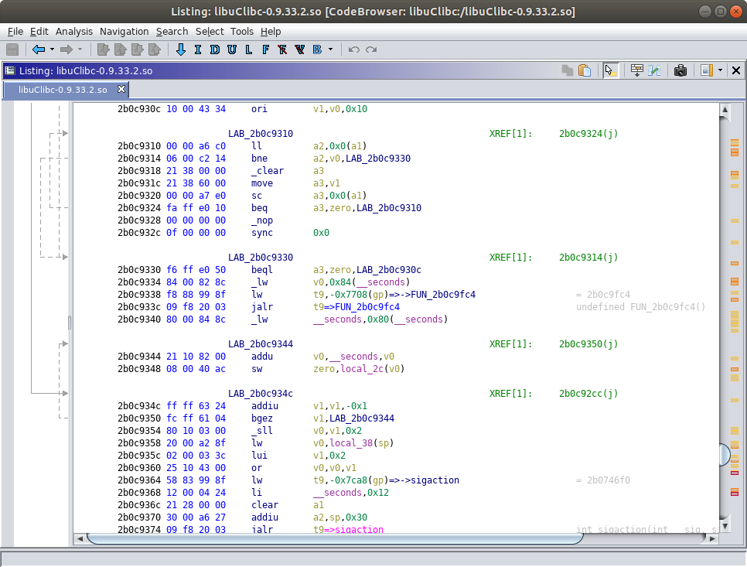
Listing View
The main window for examining a program’s instructions and data
Includes address offsets, machine code instructions, assembly code instructions
Branching and function calls are illustrated with the arrows on the left
Annotations for symbol names, cross references, and strings are included

Slide 50
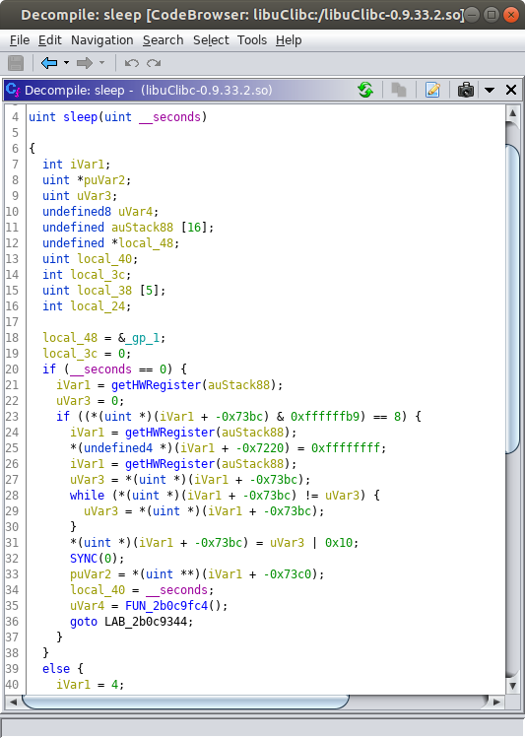
Decompiler View
A C language representation of the active function selected in the Listing View
The user can rename arguments and variables and change data types
Selections and edits are dynamically synced between the Listing View and Decompiler View

Slide 51
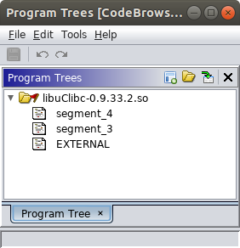
Program Trees View
Program Trees may be used to organize sections of a program
Portions of the program can be selected and associated with a “fragment”
Some fragments are automatically created based on segments defined in the program
New fragments can be defined and code units can be associated with different fragments
Code units can only be associated with one fragment
Fragments cans can be organized into folders
Folders can also be nested within other folders

Slide 52
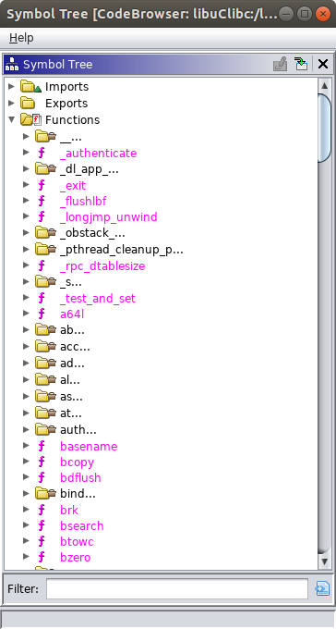
Symbol Tree View
Shows a hierarchical view of symbols in a program
Imports
Exports
Functions
Labels
Classes
Namespaces
Clicking on a symbol in the Symbol Tree navigates to where that symbol appears in the Listing View
The Symbol Tree view includes a filter field that is helpful for quickly finding a symbol and navigating to it

Slide 53
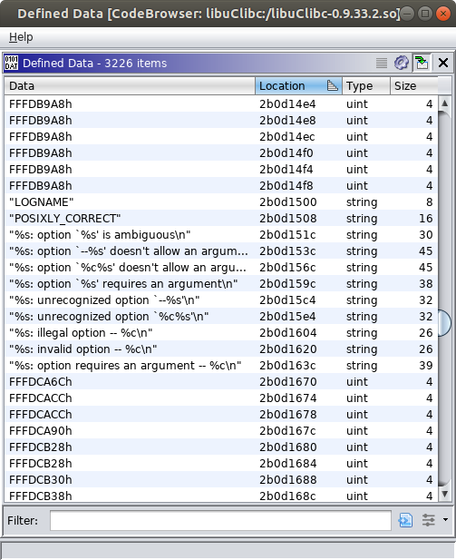
Defined Data View
Not shown by default, but can be added by selecting it from the Window menu in the Code Browser
Shows data (e.g. strings, integers) defined within the program
e.g. Global or local variables
This view also contains a filtering capability
Can be especially helpful for reverse engineering programs, especially when some of this data appears as program output and and you want to examine the code around it

Slide 54
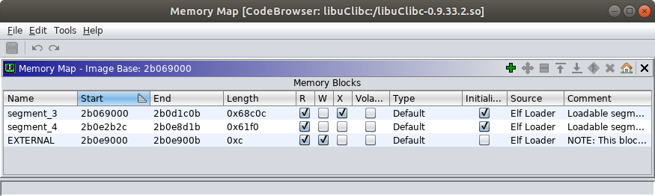
Memory Map View
Not shown by default, but can be added by selecting it from the Window menu in the Code Browser
Helpful for identifying program segments and the memory protections applied to them
Readable, Writable, Executable

Slide 55
Return Oriented Programming
ROP

Slide 56
ROP Overview
What
ROP leverages existing executable machine code already present in a running process to achieve the exploitation objectives
Why
Contemporary systems often use a protection mechanism that prevents memory regions from being both writable and executable (W^X, DEP)
This protects against exploits that write shellcode onto the stack then execute it
Aleph One described these techniques in his 1996 Phrack paper, “Smashing The Stack For Fun And Profit” [1]
Even when W^X protections are not used, ROP is effective in cases where...
The vulnerability does not allow sufficient space to write useful shellcode into memory
The interface constrains the set of characters (byte) values that can be passed to the vulnerable program
Notes:
[5] Aleph One, “Smashing The Stack For Fun And Profit,” Phrack, vol. 7, issue 49, Nov. 8, 1996. [Online]. Available: http://phrack.org/issues/49/14.html. [Accessed Aug. 30, 2019].

Slide 57
ROP Evolution
Return-into-libc
An evolutionary step toward generalized ROP techniques
In 1997, Solar Designer published a proof of concept return-into-libc exploit, and defense recommendations, on a Bugtraq mailing list [6]
The exploit involves using a buffer overflow vulnerability to write function arguments and the virtual memory address of a libc function onto the stack such that exploited function returns to the chosen libc function instead of the calling function
Return-Oriented Programming (ROP)
ROP as we know it, is generally attributed to Hovav Shacham based on his 2007 paper, “The Geometry of Innocent Flesh on the Bone: Return-into-libc without Function Calls (on the x86)” [7]
ROP generalizes the return-into-libc approach because doesn’t return to entire functions
Instead, ROP returns into short sequences of code called “Gadgets”
Return-Oriented Programming (ROP) for the ARM Architecture
Tim Kornau’s 2009 thesis, “Return Oriented Programming for the ARM Architecture,” provides an overview of ROP in the context of ARM and algorithms for searching for ROP gadgets [8]
Notes:
[6] Solar Designer, “Getting around non-executable stack (and fix),” Bugtraq, Aug. 10, 1997. [Online]. Available: https://seclists.org/bugtraq/1997/Aug/63. [Accessed Aug. 30, 2019].
[7] H. Shacham, “The geometry of innocent flesh on the bone: return-into-libc without function calls (on the x86),” In Proc. 14th ACM conference on Computer and Communications Security, 2007, pp. 552-561.
[8] T. Kornau, “Return Oriented Programming for the ARM Architecture.” M.S. thesis, Ruhr-Universität Bochum, Dec. 22, 2009. [Online]. Available: http://zynamics.com/downloads/kornau-tim--diplomarbeit--rop.pdf. [Accessed Aug. 30, 2019]

Slide 58
ROP Gadgets
ROP Gadgets are sequences of machine code with these attributes (generally)
Short
Anywhere from 2 to roughly 10 instructions
No function prologue or epilogue
These are not entire functions, just pieces of functions
No defined behavior
Functions typically have defined arguments, processing behaviors, and return values that are described in documentation
ROP gadgets are pieces of functions and don’t necessarily associate to a single line of source code
Programmers do not directly author ROP gadgets, they are part of what gets created when source code is built
The exact machine code produced from the source code varies based on the target architecture, the compiler, compiler optimizations, etc.

Slide 59
Using Ghidra to find ROP Gadgets

Slide 60
Finding ROP Gadgets With Ghidra
Scenario
We are developing a proof-of-concept exploit for a program on a MIPS system
The program accepts input via an UPnP interface (SOAP over HTTP)
Our exploit will call the system function in the libc library
The system function accepts one argument, which is a pointer to a string containing a command to execute
What we need to do
Populate the $a0 register with the address of the command string we want to execute
Have execution reach the system function in libc
What we’ve already determined
There is a stack-based buffer overflow vulnerability in the target program
By overflowing the buffer we are able to control the contents of the following registers:
$s0-$s8
$ra
Using another interface on the target program we are able to write a command string into memory at address 0x2b324041
The libc library is loaded into the virtual address space of the target process at offset 0x2b069000 (the end of the executable memory segment of libc is at offset 0x2b0d2000)

Slide 61
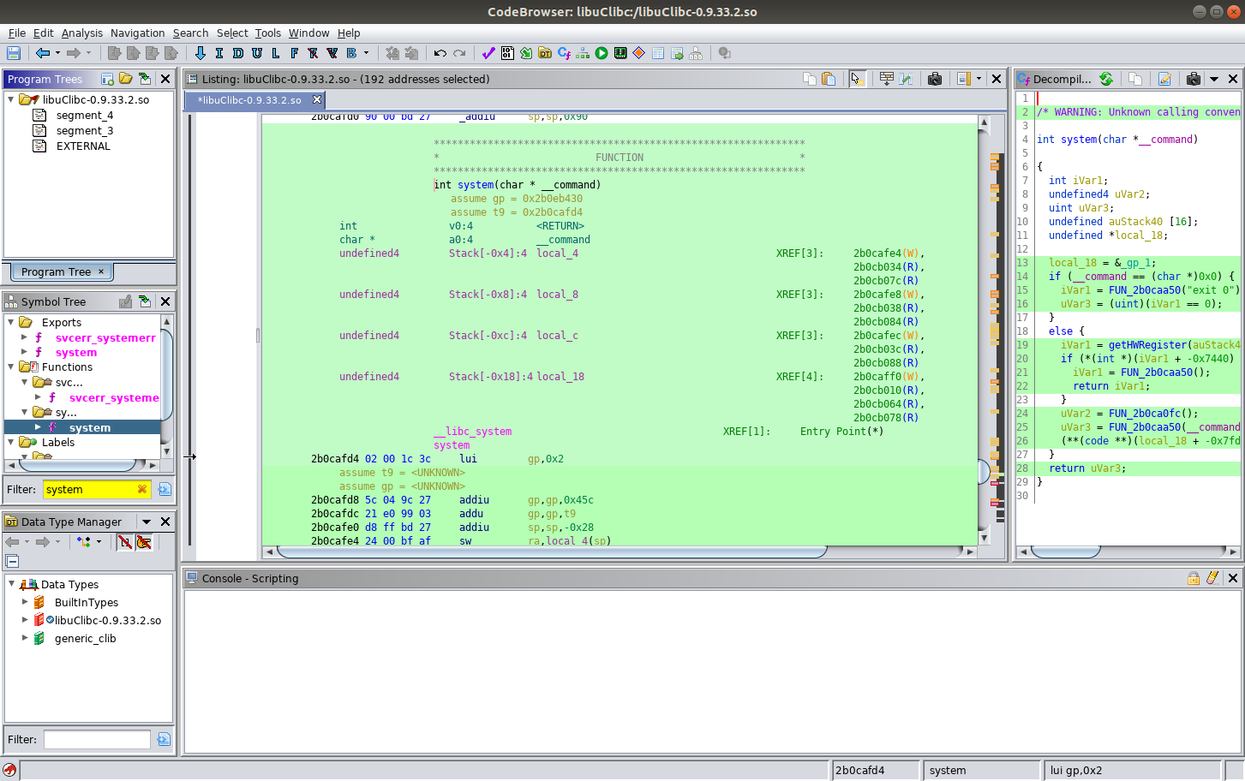
Finding the Address of the system Function in libc
The libc library we are analyzing includes a symbol for the system function so we can use the filter in the Symbol Tree to find it

Slide 62
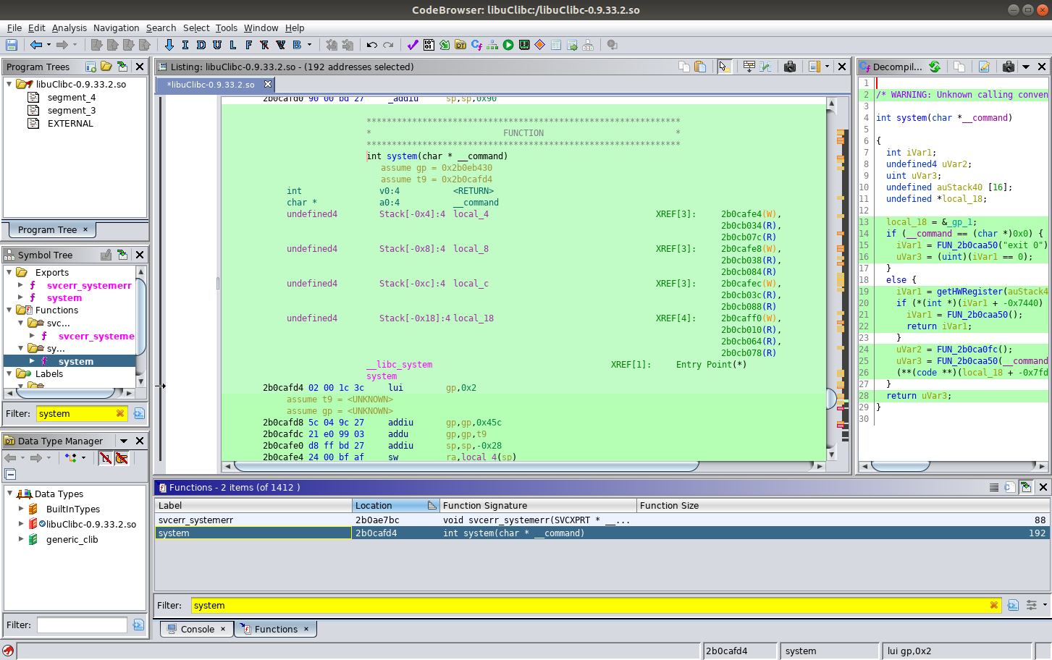
Finding the Address of the system Function in libc
Alternatively, we can find the system function by filtering or sorting in the Functions View

Slide 63
Address of the system Function in libc
The system function is located at virtual address 0x2b0cafd4

Slide 64
Dealing with Bad Characters
We mentioned that our target program accepts input via an UPnP interface (SOAP over HTTP)
This protocol constrains the values of the input characters significantly
Supported characters are:
0x09 (Horizontal Tab)
0x0a (Line Feed)
0x0d (Carriage Return)
0x20-0x7e (Printable ASCII Characters)
There are some other exceptions for special characters that have special meanings in XML or HTTP (e.g. ‘<’ and ‘>’), but for this demonstration we will ignore those unless they cause an issue
All of the bytes in the address containing our command string (0x2b324041) are safe
The system function is located at address 0x2b0cafd4, but
Three of those bytes are bad characters so we won’t be able to pass them in directly via the UPnP interface
Instead, we will need to pass in safe values and find gadgets that will compute the correct address for system

Slide 65
ROP Gadget Requirements
We can control the following registers via a stack-based buffer overflow:
$s0-$s8
$ra
We need to find a sequence of ROP gadgets that perform the following operations
Move the value 0x2b324041 into $a0 from one of the saved registers ($s0-$s8)
This is the address of the command string
Compute the value 0x2b0cafd4 using operands made of safe characters
There are several ways to do this
Arithmetic operations (e.g. add, subtract)
Logical operations (e.g. XOR, AND)
Move the computed 0x2b0cafd4 value into the $ra register
This is the address of the system function

Slide 66
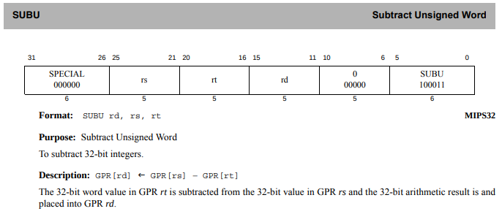
Finding Our First Gadget
At a minimum, let’s try to find a gadget that computes the address of the system function using values stored in the registers we control
We’ll start by finding an unsigned subtraction instruction that computes the address of the system function
Refer to the MIPS32 Instruction Set Manual for the structure of the SUBU instruction
Note that some of the bits in the 4 byte instruction are fixed for the SUBU instruction and some are used to refer to the operands
0x4b2d2e52 - 0x20207e7e = 0x2b0cafd4
The MIPS32® Instruction Set Manual [9]
Notes:
[9] MIPS Technologies Inc., “MIPS® Architecture for Programmers Volume II-A: The MIPS32® Instruction Set Manual,” Doc. No. MD00086, Rev. 6.06, Dec. 15, 2016. [Online]. Available: https://www.mips.com/?do-download=the-mips32-instruction-set-v6-06. [Accessed Aug. 30, 2019].

Slide 67
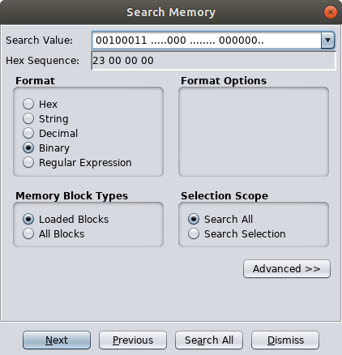
Finding a SUBU Instruction
Ghidra provides a memory search feature we can use to find instances of machine code instructions independent of the specific operands
The ‘Search Memory’ dialog may be launched by choosing ‘Search’ → ‘Memory…’ from the Ghidra CodeBrowser window
The dots in the search value
will match any bit value
The dots are placed where registers are encoded in the SUBU instruction
The MIPS32® Instruction Set Manual [9]

Slide 68
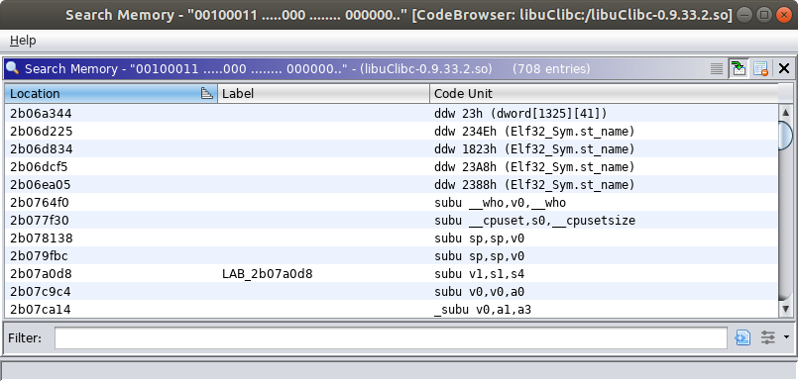
Finding a SUBU Instruction
Our search found 708 possibilities
Not all of them are the SUBU instructions we were looking for
Some of the addresses contain bad characters
Click this button to access the filtering interface

Slide 69
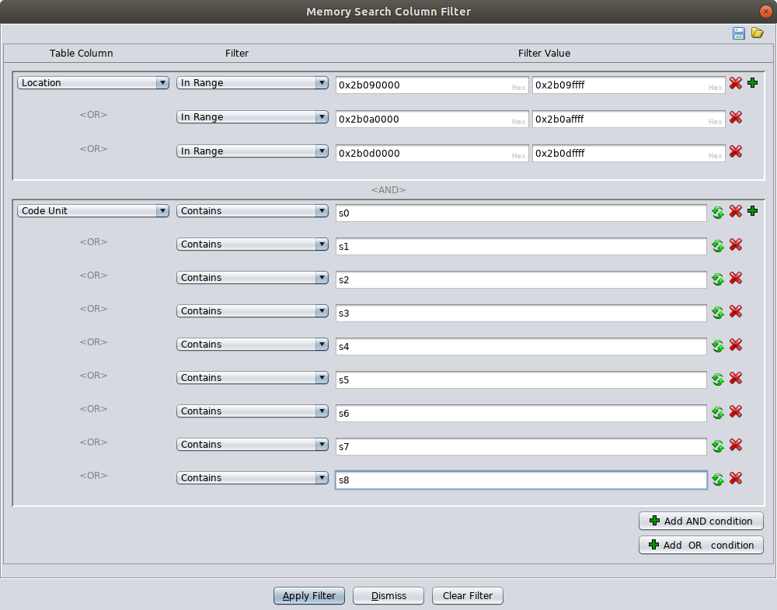
Finding a SUBU Instruction
We can filter by the location of the instruction
We can also filter by strings in the assembly instructions
Here we look for instructions that use registers we control as operands

Slide 70
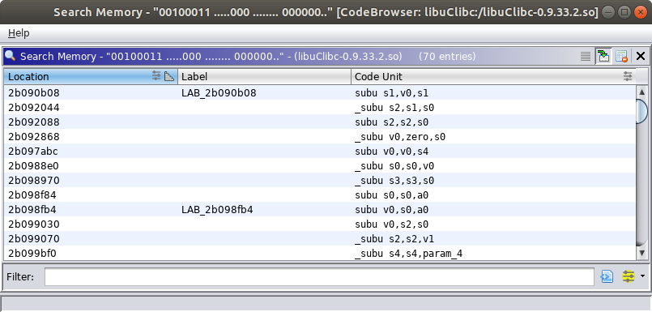
Finding a SUBU Instruction
Some of the addresses still contain bad characters because we didn’t filter based on the two least significant bytes
Our filter narrowed the candidates down to 70
...but 70 is a small enough number for us to work through manually
Not all of the instructions use operands we control
Notes:
Didn’t filter on the two least significant bytes because the filter would have been too granular to define manually

Slide 71
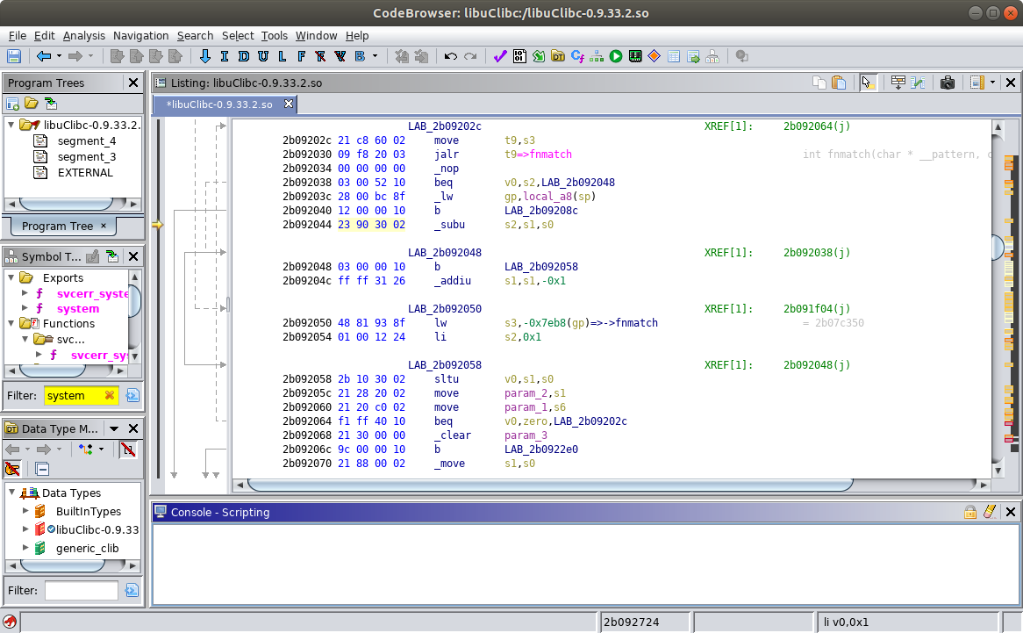
SUBU → “Subtract Unsigned Word”
One of the unsigned subtraction instructions we found with our memory search in Ghidra

Slide 72
The table below shows the registers we can control
As we examine the gadgets we’ll capture the register values we need in the table below.
The ‘orange’ values will need to be set by exploiting the buffer overflow vulnerability in the target program.
The ‘green’ values are computed and set by the code in the ROP gadgets. We record them below to to track their state and indicate their limited availability.
$s0 = dontcare
$s1 = dontcare
$s2 = dontcare
$s3 = dontcare
$ra = dontcare
$s4 = dontcare
$s5 = dontcare
$s6 = dontcare
$s7 = dontcare
$s8 = dontcare
Orange → Set this value Green → Computed value

Slide 73
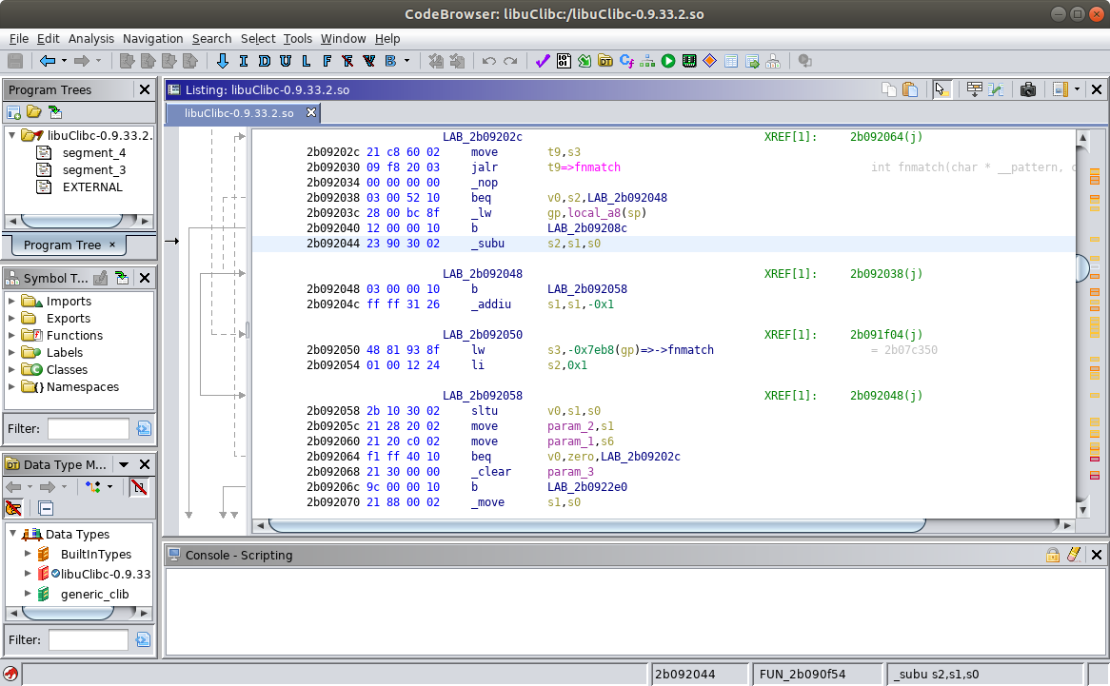
This is our first gadget.
We need to use the buffer overflow to set the value of $ra to 0x2b092044 so we reach this code
$s0 = dontcare
$s1 = dontcare
$s2 = dontcare
$s3 = dontcare
$ra = 2b092044
$s4 = dontcare
$s5 = dontcare
$s6 = dontcare
$s7 = dontcare
$s8 = dontcare
Orange → Set this value Green → Computed value

Slide 74
$s2 = $s1 - $s0
We need to make sure $s1 and $s0 are set correctly so we get the address of ‘system’ stored in $s2
$s0 = 20207e7e
$s1 = 4d2d2e52
$s2 = 2b0cafd4
$s3 = dontcare
$ra = 2b092044
$s4 = dontcare
$s5 = dontcare
$s6 = dontcare
$s7 = dontcare
$s8 = dontcare
Orange → Set this value Green → Computed value

Slide 75
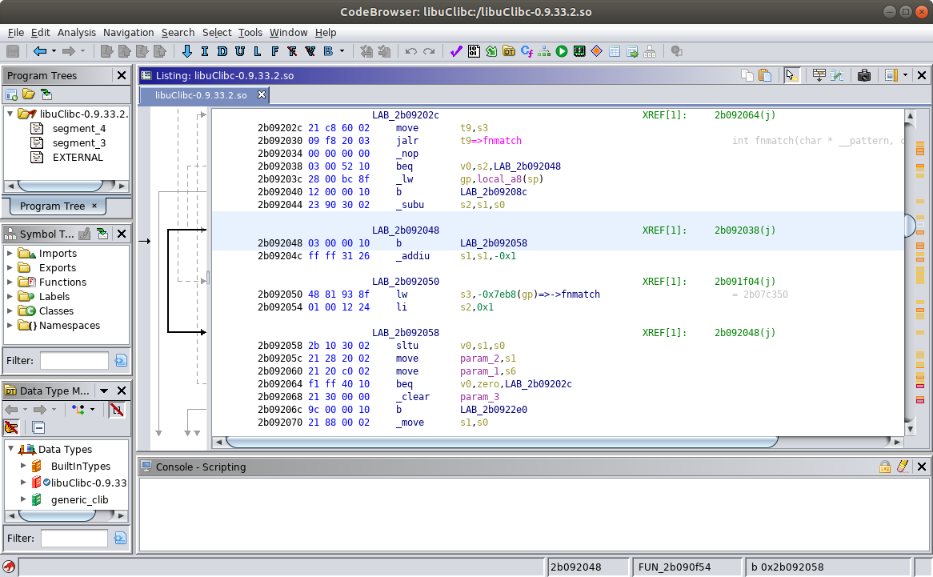
At this point we are “along for the ride”
Unconditional branch to offset 0x2b092058
$s0 = 20207e7e
$s1 = 4d2d2e52
$s2 = 2b0cafd4
$s3 = dontcare
$ra = 2b092044
$s4 = dontcare
$s5 = dontcare
$s6 = dontcare
$s7 = dontcare
$s8 = dontcare
Orange → Set this value Green → Computed value

Slide 76
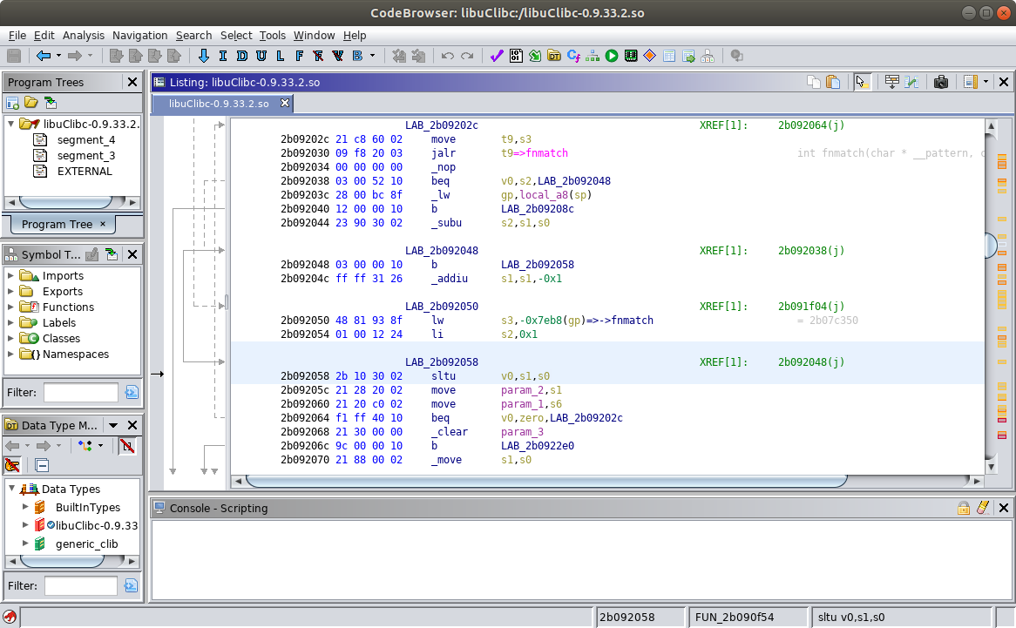
SLTU → “Set on Less Than Unsigned”
The value in $s1 is NOT less than the value stored in $s0 so $v0 is set to 0 (false)
$v0 = 0
$s0 = 20207e7e
$s1 = 4d2d2e52
$s2 = 2b0cafd4
$s3 = dontcare
$ra = 2b092044
$s4 = dontcare
$s5 = dontcare
$s6 = dontcare
$s7 = dontcare
$s8 = dontcare
Orange → Set this value Green → Computed value

Slide 77
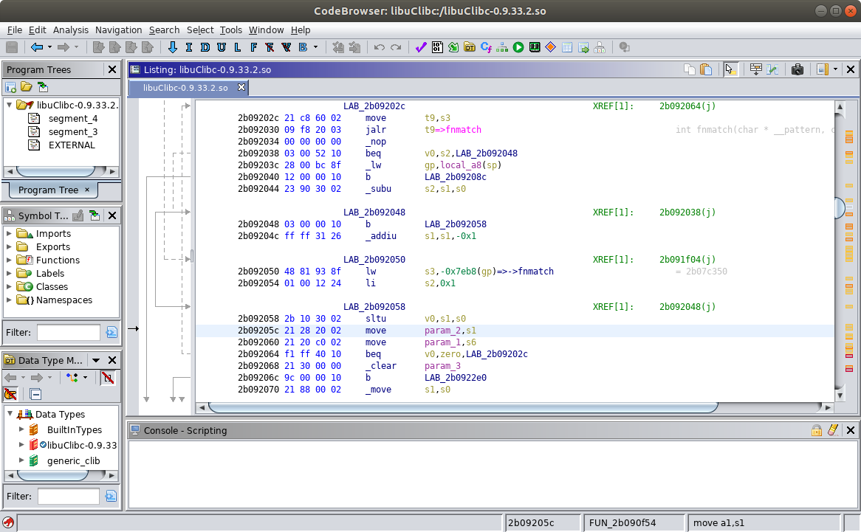
Move the value stored in $s1 into param_2
This doesn’t accomplish anything we need, but it doesn’t hurt us
$v0 = 0
$s0 = 20207e7e
$s1 = 4d2d2e52
$s2 = 2b0cafd4
$s3 = dontcare
$ra = 2b092044
$s4 = dontcare
$s5 = dontcare
$s6 = dontcare
$s7 = dontcare
$s8 = dontcare
Orange → Set this value Green → Computed value

Slide 78

Move the value stored in $s6 into param_1
What is param_1?
$v0 = 0
$s0 = 20207e7e
$s1 = 4d2d2e52
$s2 = 2b0cafd4
$s3 = dontcare
$ra = 2b092044
$s4 = dontcare
$s5 = dontcare
$s6 = dontcare
$s7 = dontcare
$s8 = dontcare
Orange → Set this value Green → Computed value

Slide 79
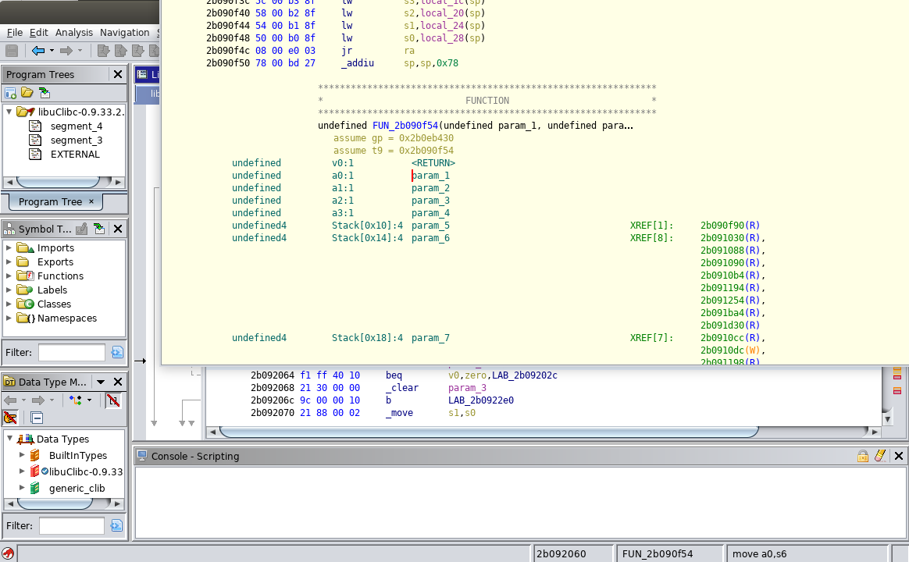
param_1 is an alias for $a0
We can mouse over param_1 and see where it is defined
$v0 = 0
$s0 = 20207e7e
$s1 = 4d2d2e52
$s2 = 2b0cafd4
$s3 = dontcare
$ra = 2b092044
$s4 = dontcare
$s5 = dontcare
$s6 = dontcare
$s7 = dontcare
$s8 = dontcare
Orange → Set this value Green → Computed value

Slide 80
We want to put the address of our command into $s6 so it will get moved into $a0 as the argument for the ‘system’ call
param_1 is an alias for $a0
$v0 = 0
$a0 = 2b324041
$s0 = 20207e7e
$s1 = 4d2d2e52
$s2 = 2b0cafd4
$s3 = dontcare
$ra = 2b092044
$s4 = dontcare
$s5 = dontcare
$s6 = 2b324041
$s7 = dontcare
$s8 = dontcare
Orange → Set this value Green → Computed value

Slide 81

Branch to offset 0x2b09202c if $v0 = 0
(it does)
$v0 = 0
$a0 = 2b324041
$s0 = 20207e7e
$s1 = 4d2d2e52
$s2 = 2b0cafd4
$s3 = dontcare
$ra = 2b092044
$s4 = dontcare
$s5 = dontcare
$s6 = 2b324041
$s7 = dontcare
$s8 = dontcare
Orange → Set this value Green → Computed value

Slide 82
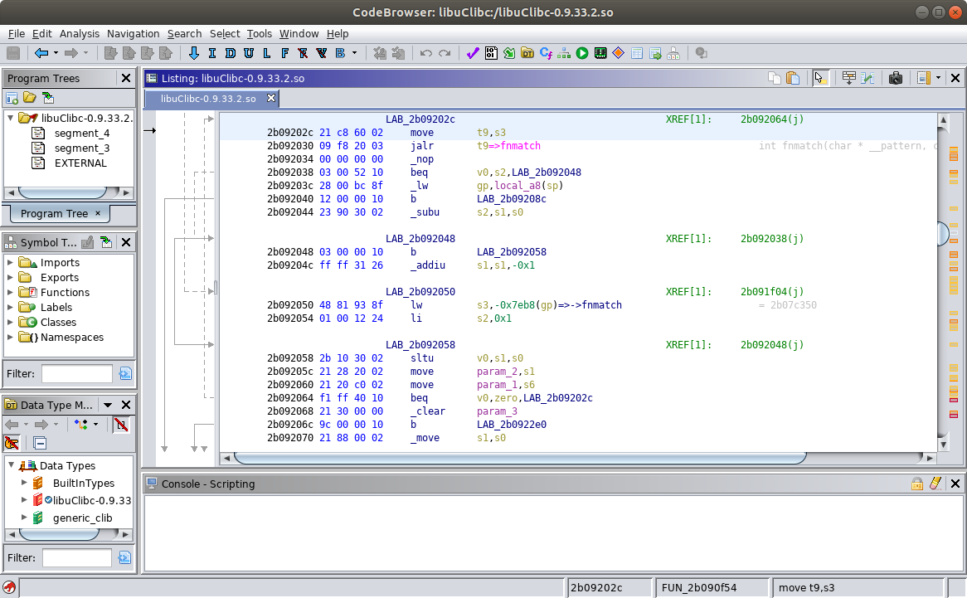
Move the value in $s3 into $t9
$t9 = $s3
$a0 = 2b324041
$s0 = 20207e7e
$s1 = 4d2d2e52
$s2 = 2b0cafd4
$s3 = dontcare
$ra = 2b092044
$s4 = dontcare
$s5 = dontcare
$s6 = 2b324041
$s7 = dontcare
$s8 = dontcare
Orange → Set this value Green → Computed value

Slide 83
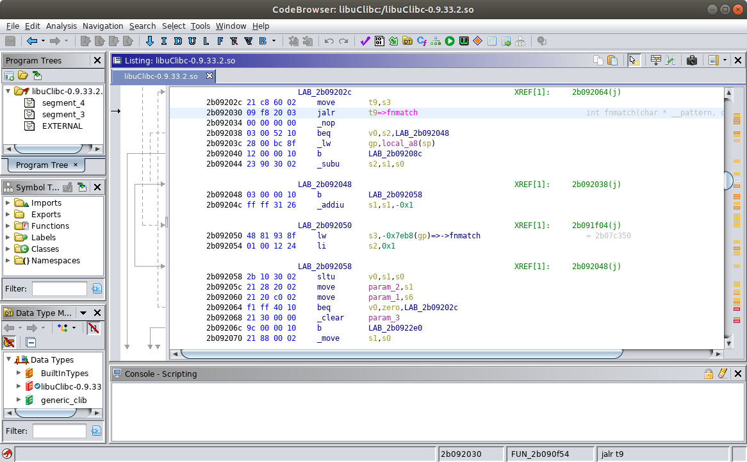
JALR → “Jump and Link Register”
Set the program counter to the value stored in $t9
...which is the same as the value stored in $s3
(we control $s3)
$t9 = $s3
$a0 = 2b324041
$s0 = 20207e7e
$s1 = 4d2d2e52
$s2 = 2b0cafd4
$s3 = dontcare
$ra = 2b092044
$s4 = dontcare
$s5 = dontcare
$s6 = 2b324041
$s7 = dontcare
$s8 = dontcare
Orange → Set this value Green → Computed value

Slide 84
JALR → “Jump and Link Register”
Set the program counter to the value stored in $t9
...which is the same as the value stored in $s3
(we directly control $s3)
So $s3 needs to contain the address of our next gadget
$t9 = 2nd gadget
$a0 = 2b324041
$s0 = 20207e7e
$s1 = 4d2d2e52
$s2 = 2b0cafd4
$s3 = 2nd gadget
$ra = 2b092044
$s4 = dontcare
$s5 = dontcare
$s6 = 2b324041
$s7 = dontcare
$s8 = dontcare
Orange → Set this value Green → Computed value

Slide 85
ROP Gadget Requirements Review
We can control the following registers via a stack-based buffer overflow:
$s0-$s8
$ra
We need to find a sequence of ROP gadgets that perform the following operations
Move the value 0x2b324041 into $a0 from one of the saved registers ($s0-$s8)
This is the address of the command string
Compute the value 0x2b0cafd4 using operands made of safe characters
There are several ways to do this
Arithmetic operations (e.g. add, subtract)
Logical operations (e.g. XOR, AND)
Move the computed 0x2b0cafd4 value into the $ra register
This is the address of the system function
✔
✔

Slide 86
Finding Our Second Gadget
At the end of the first gadget we had an instruction that… moved a value from a saved register into $t9...followed by an instruction that… jumped to the address in $t9
Let’s look for another sequence like that
...except we want one that moves the value in $s2 into $t9
because $s2 has the address of ‘system’

Slide 87
About the MIPS MOVE instruction
We saw a MIPS MOVE instruction in Ghidra’s disassembly
To search for the specific instruction we want (move t9,s2) we should consult the MIPS32 Instruction Set Reference to find the correct machine code bytes
...but there is no MIPS MOVE instruction
The MOVE instruction is really a pseudoinstruction
The assembler interprets…
move rd, rs
as
addu rd, rs, zero
Note: The zero register always holds the value zero

Slide 88
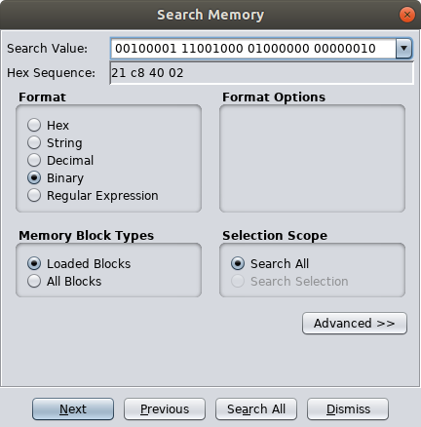
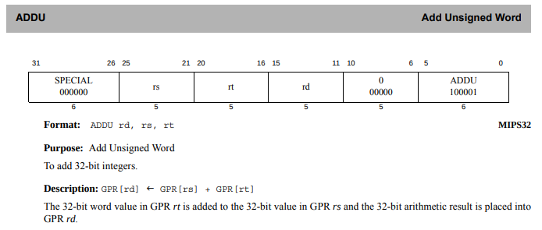
Finding a ‘move t9,s2’ Instruction
We use the memory search feature to search specifically for an
addu t9,s2,zero instruction
There are no dots in the search value because we are searching for a specific instruction
The MIPS32® Instruction Set Manual [9]

Slide 89
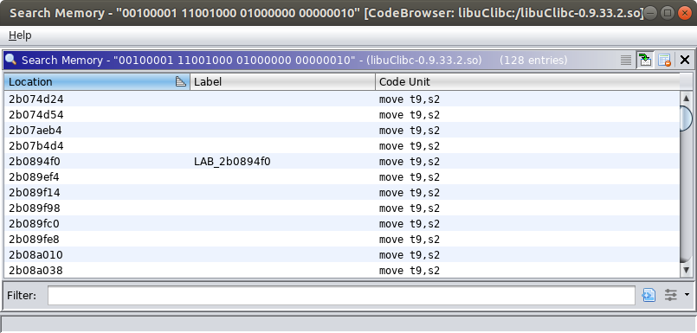
Finding a ‘move t9,s2’ instruction
Our search found 128 possibilities
Some of the addresses contain bad characters
Click this button to access the filtering interface

Slide 90
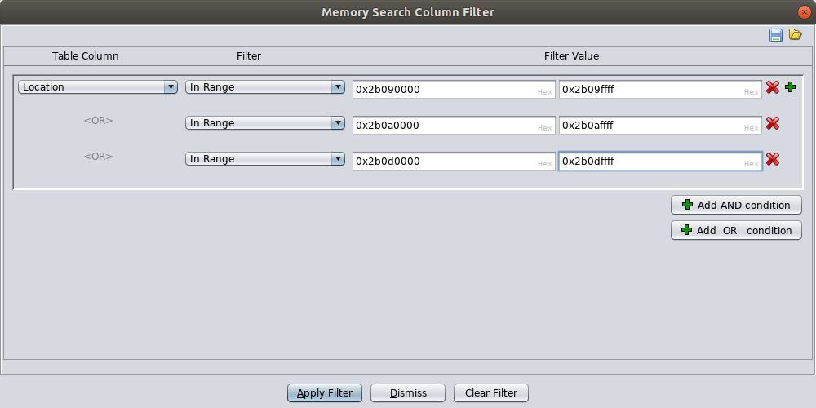
Finding a ‘move t9,s2’ instruction
We can filter by the location of the instruction
Note: We aren’t filtering based on the two least significant bytes because the filter would be too granular to define manually

Slide 91
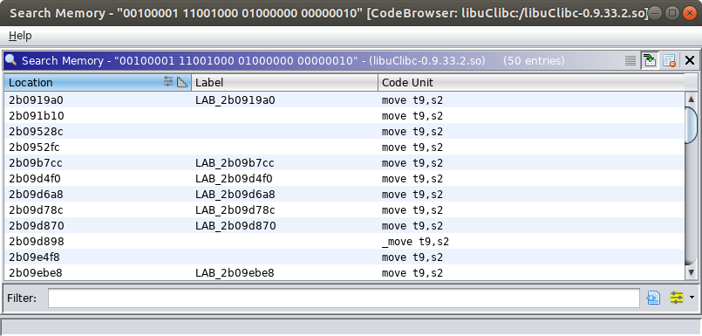
Finding a ‘move t9,s2’ instruction
Some of the addresses still contain bad characters because we didn’t filter based on the two least significant bytes
Our filter narrowed the candidates down to 50

Slide 92
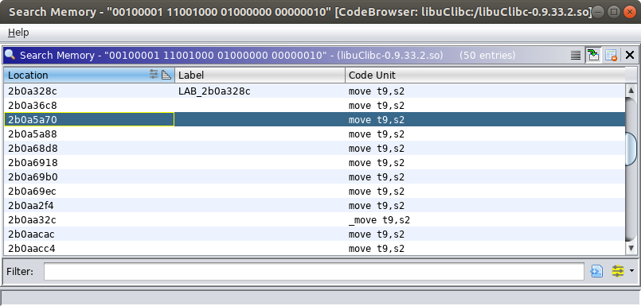
Finding a ‘move t9,s2’ instruction
This gadget is located at an address with all safe characters and performs the operations we need

Slide 93
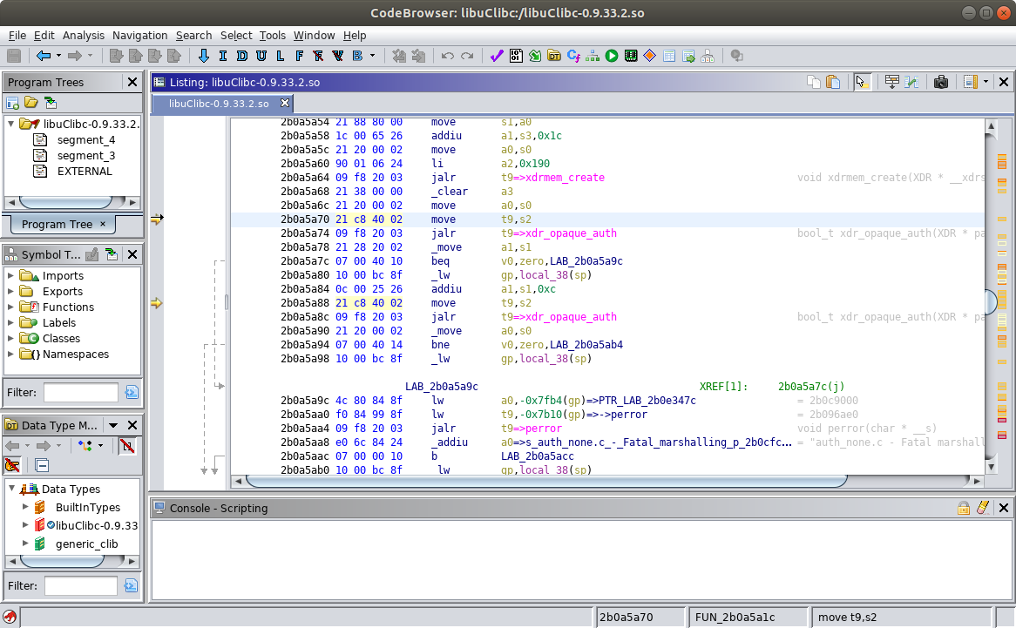
One of the move t9,s2 instructions we found with our memory search in Ghidra

Slide 94
We want to reach the instruction at this address (because this is the address of the system function) after the second gadget finishes executing.
We continue populating the table we started earlier.
$a0 = 2b324041
$s0 = 20207e7e
$s1 = 4d2d2e52
$s2 = 2b0cafd4
$s3 = 2nd gadget
$ra = 2b092044
$s4 = dontcare
$s5 = dontcare
$s6 = 2b324041
$s7 = dontcare
$s8 = dontcare
Orange → Set this value Green → Computed value

Slide 95
Based on the first gadget we determined we need to populate the $s3 register with the address of the second gadget.
We need to use the buffer overflow to set the value of $s3 to 0x2b0a5a70 so we reach this code
$a0 = 2b324041
$s0 = 20207e7e
$s1 = 4d2d2e52
$s2 = 2b0cafd4
$s3 = 2b0a5a70
$ra = 2b092044
$s4 = dontcare
$s5 = dontcare
$s6 = 2b324041
$s7 = dontcare
$s8 = dontcare
Orange → Set this value Green → Computed value

Slide 96
Move the value in $s2 into $t9
$t9 = 2b0cafd4
$a0 = 2b324041
$s0 = 20207e7e
$s1 = 4d2d2e52
$s2 = 2b0cafd4
$s3 = 2b0a5a70
$ra = 2b092044
$s4 = dontcare
$s5 = dontcare
$s6 = 2b324041
$s7 = dontcare
$s8 = dontcare
Orange → Set this value Green → Computed value

Slide 97

JALR → “Jump and Link Register”
Set the program counter to the value stored in $t9
...which is the same as the value stored in $s2
(we indirectly control $s2)
$t9 = 2b0cafd4
$a0 = 2b324041
$s0 = 20207e7e
$s1 = 4d2d2e52
$s2 = 2b0cafd4
$s3 = 2b0a5a70
$ra = 2b092044
$s4 = dontcare
$s5 = dontcare
$s6 = 2b324041
$s7 = dontcare
$s8 = dontcare
Orange → Set this value Green → Computed value

Slide 98
JALR → “Jump and Link Register”
Set the program counter to the value stored in $t9
...which is the same as the value stored in $s2
(the first gadget populated $s2)
$t9 contains the address of the system function
...and after the jalr instruction is executed we will reach the system function
$a0 contains the address of the command string we want the system function to execute
(the first gadget populated $s2)
The system function will find its
argument in the $a0 register.
$t9 = 2b0cafd4
$a0 = 2b324041
$s0 = 20207e7e
$s1 = 4d2d2e52
$s2 = 2b0cafd4
$s3 = 2b0a5a70
$ra = 2b092044
$s4 = dontcare
$s5 = dontcare
$s6 = 2b324041
$s7 = dontcare
$s8 = dontcare
Orange → Set this value Green → Computed value

Slide 99
ROP Gadget Requirements Review
We can control the following registers via a stack-based buffer overflow:
$s0-$s8
$ra
We need to find a sequence of ROP gadgets that perform the following operations
Move the value 0x2b324041 into $a0 from one of the saved registers ($s0-$s8)
This is the address of the command string
Compute the value 0x2b0cafd4 using operands made of safe characters
There are several ways to do this
Arithmetic operations (e.g. add, subtract)
Logical operations (e.g. XOR, AND)
Move the computed 0x2b0cafd4 value into the $ra register
This is the address of the system function
✔
✔
✔

Slide 100
ROP Gadgets With Ghidra: Conclusions
We used off-the-shelf features in Ghidra to find a sequence of two ROP gadgets that perform register manipulations needed to construct a proof-of-concept exploit
This work would be preceded by vulnerability identification and characterization using fuzzing and debugging, which we did not cover here
Ghidra’s off-the-shelf GUI features helped us do this reasonably efficiently
The automation and scripting features provided by Ghidra can improve our efficiency
The difficult part of constructing ROP chains is examining candidate gadgets to find ones that...
Do, at least, perform the necessary operations
Do not perform operations that undo or invalidate the results of previous operations
Olivia Lucca Fraser (a.k.a. Oblivia Simplex) presents interesting and recent research in her master's thesis related to algorithms and tooling for ROP chain generation [10] [11]
Notes:
[10] O. L. Fraser, “Urschleim in Silicon: Return Oriented Program Evolution with ROPER,” M.S. thesis, Dalhousie University, Halifax, Nova Scotia, Dec. 2018. [Online]. Available: https://pdfs.semanticscholar.org/959e/d1164c7919e9bc22779c75b13c32f4e37129.pdf. [Accessed Aug. 30, 2019].
[11] O. L. Fraser (Oblivia-Simplex), “Return Oriented Programme Evolution with ROPER,” [Online]. Available: https://github.com/oblivia-simplex/roper. [Accessed Aug. 30, 2019].

Slide 101
References

Slide 102
References
1] E. J. Chikofsky and J. H. Cross, “Reverse engineering and design recovery: A taxonomy,” IEEE Software, vol. 7, pp. 13-17, 1990.
[2] Trend Micro Inc., “Back-to-Back Campaigns: Neko, Mirai, and Bashlite Malware Variants Use Various Exploits to Target Several Routers, Devices,” Trend Micro Security Intelligence Blog, Aug. 13, 2019. [Online]. Available: https://blog.trendmicro.com/trendlabs-security-intelligence/back-to-back-campaigns-neko-mirai-and-bashlite-malware-variants-use-various-exploits-to-target-several-routers-devices/. [accessed Aug. 30, 2019].
[3] S. Hollister, “Hackers obtain PS3 private cryptography key due to epic programming fail? (update),” Engadget, Dec. 29, 2010. [Online]. Available: https://www.engadget.com/2010/12/29/hackers-obtain-ps3-private-cryptography-key-due-to-epic-programm/. [Accessed Aug. 30, 2019].
[4] C. Johnston, “PS3 hacked through poor cryptography implementation,” Ars Technica, Dec. 20, 2010. [Online]. Available: https://arstechnica.com/gaming/2010/12/ps3-hacked-through-poor-implementation-of-cryptography/. [Accessed Aug. 30, 2019].

Slide 103
References
[5] Aleph One, “Smashing The Stack For Fun And Profit,” Phrack, vol. 7, issue 49, Nov. 8, 1996. [Online]. Available: http://phrack.org/issues/49/14.html. [Accessed Aug. 30, 2019].
[6] Solar Designer, “Getting around non-executable stack (and fix),” Bugtraq, Aug. 10, 1997. [Online]. Available: https://seclists.org/bugtraq/1997/Aug/63. [Accessed Aug. 30, 2019].
[7] H. Shacham, “The geometry of innocent flesh on the bone: return-into-libc without function calls (on the x86),” In Proc. 14th ACM conference on Computer and Communications Security, 2007, pp. 552-561.
[8] T. Kornau, “Return Oriented Programming for the ARM Architecture.” M.S. thesis, Ruhr-Universität Bochum, Dec. 22, 2009. [Online]. Available: http://zynamics.com/downloads/kornau-tim--diplomarbeit--rop.pdf. [Accessed Aug. 30, 2019].
[9] MIPS Technologies Inc., “MIPS® Architecture for Programmers Volume II-A: The MIPS32® Instruction Set Manual,” Doc. No. MD00086, Rev. 6.06, Dec. 15, 2016. [Online]. A[vailable: https://www.mips.com/?do-download=the-mips32-instruction-set-v6-06. [Accessed Aug. 30, 2019].

Slide 104
References
[10] O. L. Fraser, “Urschleim in Silicon: Return Oriented Program Evolution with ROPER,” M.S. thesis, Dalhousie University, Halifax, Nova Scotia, Dec. 2018. [Online]. Available: https://pdfs.semanticscholar.org/959e/d1164c7919e9bc22779c75b13c32f4e37129.pdf. [Accessed Aug. 30, 2019].
[11] O. L. Fraser (Oblivia-Simplex), “Return Oriented Programme Evolution with ROPER,” [Online]. Available: https://github.com/oblivia-simplex/roper. [Accessed Aug. 30, 2019].

